Slide 1

S.A.F.E. Firearm Clinician Training
Jennifer M Boggs, PhD, MSW
Scientist in Residence - Kaiser Permanente Center for Gun Violence Research and Education
Research Investigator – Kaiser Permanente Colorado Institute for Health Research

Slide 2
Who have we engaged in the development of this work?
National Permanente | Kari Carlson Steve Parodi
National Health Plan | Bechara Choucair Trish Rodriguez
National Community & Social Health | Anand Shah John Vu Jennifer Frost Nancy Taylor | Kendall Stagg Jennifer Jordan Amanda Van Vleet
Northern California Permanente | Angela Wong Paul Espinas Tricia Tayama Erica Van Den Haak Alan Man | Nichole Choi Maya Legget Anastasia Van Engelen Mitali Nanda
Northern California Community & Social Health | Jean Nudelman Alisha Somji | Kadin Caines Lynn Deguzman
Subject Matter Expert / Scientific Team | Jennifer Boggs Julie Angerhofer Stacy Sterling Rebecca Zeibell | Glenn Goodrich LeeAnn Quintana Erika Holden Maricela Cruz
Community Health Project Team | Kelly O’Neal Jesse Gelwicks | Chantal Sullivan Kayla Cathers
Data Team | Garett Ng Simran Gill

Slide 3
BACKGROUND
"I know that when we were very first starting, there were a number of providers that expressed concerns about not feeling comfortable talking about this with their patients. And subsequent conversations have alleviated a lot of those concerns. I think most of the people who have been doing this for a while now feel pretty comfortable.“
KP Colorado Pediatric Clinician

Slide 4
Remember C.A.R.E. for 1- minute conversations about firearm safety
C
    Concern for safety
    This is what motivates the conversation, not a political agenda.
A
    Access prevention everywhere
    Firearms can be accessed within the patient’s home or elsewhere.
R
    Recommend safe storage
    Firearm is locked up to prevent unauthorized access by children.
E
    Equip and empower
    Offer firearm locks.
Notes:
We will dig into this later, but I wanted to give you a quick preview because repetition is the key to adult learning.

Slide 5
Why do pediatricians have a role in firearm safety? Can I really make a difference?
Firearms are the leading cause of death for youth
    Most kids had a pediatric visit in the year prior to death
Pediatricians are trusted messengers about safety broadly!
Firearm owning patients are open to respectful firearm conversations
Notes:
Why is it important to address firearm safety in youth? How do we do it with everything else we are asked to do?
Stress the acceptable piece

Slide 6
It’s feasible! Today we will teach you a method to have a 1-minute firearm safety conversation during all well-child visits.
Pediatric clinician counseling is effective! Proven to be change storage behavior when delivered across 47,000+ well child visits.
Notes:
Why is it important to address firearm safety in youth? How do we do it with everything else we are asked to do?
Stress the acceptable piece

Slide 7
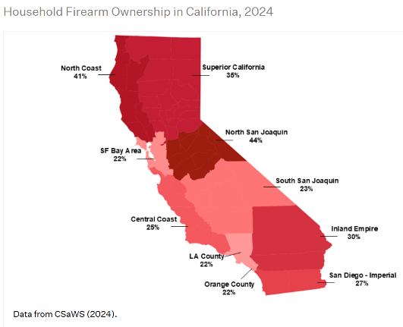
CA youth firearm statistics
~1/4 of California homes have a firearm, but considerable variability between counties.
Most firearm deaths are homicides and suicides in teens
  Social and neighborhood factors predict type of injury
  Majority of firearms used in suicides were accessed within their own or relative’s home
Accidental injuries more likely in younger children (5-9 years)
  50% accessed firearm in their own home
  50% at relative/friend’s home or other location
Firearm Ownership - BulletPoints Project
Notes:
Depending on the social and neighborhood characteristics, teens a

Slide 8
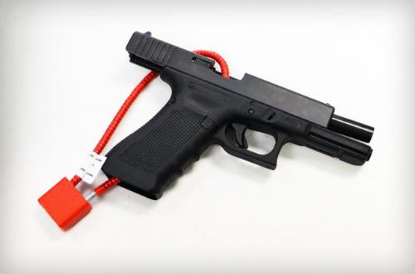
Storage is the leading modifiable risk factor for firearm injury prevention!
A 20% increase in safe firearm storage could prevent up to 32% of firearm deaths in youth, including suicide
Source. Monuteaux et al 2019. JAMA Pediatrics.

Slide 9
Let’s dig in
"I think just having the terminology was helpful. I'll say that probably was the most helpful thing because prior to that, it was our habit to ask, "Do you have firearms at home?" And you may not get an honest answer with that. So I think it was very beneficial to have the wording be, "If there are firearms, this is what we recommend." And I think people hear that better than having to answer the question. I'm not sure we would always get an honest answer.“
Pediatric clinician

Slide 10

What is S.A.F.E. Firearm?
S.A.F.E. Firearm is an evidence-based secure firearm storage program that is delivered by pediatric clinicians to all parents of youth ages 1-17 during the well-visit, regardless of firearm ownership
Brief conversation with a harm reduction lens
Free cable locks

Slide 11
Why universal?
An approach informed by firearm experts
#1 Culturally relevant: “The huge thing is that people are worried about being put into a database.“
Screening
Counseling
Maybe firearm locks offered?
Typical practice
#2 Better coverage for firearm owners: Miss up to 1/3 of firearm owners using a screening approach.
Screening
Counseling
Firearm locks
SAFE Firearm
#3 Kids are injured with guns outside their own home
Notes:
Concern that public health platform is a disguise for firearm control. This is actually simpler and more effective that when it is based on screening.
If you screen a teen and they say they aren’t sexually active, you don’t forego education. Same concept here.
**Add kids get injured with guns from outside their own homes.

Slide 12
What do you mean by harm reduction?
AAP calls this “Good, Better, Best”
Move parents to safest option they will accept
Least Safe
Most Safe
Loaded, unlocked
firearm next
to parent’s bed
Locked, unloaded, ammo locked and stored separately
Firearm unlocked and unloaded; ammo available
Firearm in a combo safe (kid doesn’t know combo), loaded
Notes:
Primary reason for ownership is protection – this isn’t consistent with the safest way to store firearms.

Slide 13
How to have the conversation
“I'll be honest, I was kind of nervous when we started to talk about this with families. But I think families have been a lot more interested and a lot more open to it than I expected.”
KP Colorado Pediatric Clinician

Slide 14
The 1-minute conversation
The Basics
Non-judgement
Normalize firearm safety by nesting it with other safety issues
Cable locks *offered* to everyone
      Some won’t take them if there are other storage options available (e.g., safes)
      Presence of cable locks helps with the conversation!
Emphasize with non-owners – “it is important to talk with those who supervise your children in other places (e.g., family or neighbors) about firearm storage.”
Notes:
So there are two topics that you probably already talk about more frequently that you can draw from those experiences to inform the firearm safety conversation, pool safety, and vaccines. Politically charged like vaccines and you’ll need to think about language and your non-verbals carefully. If you have questions on language you are using, my team is more than happy to advise on it. I will give you some language tips on the next few slides. Logistically, this is quite similar to pool safety. We’ve seen some physicians get tripped up because they aren’t familiar with guns and they wouldn’t know how to install a cable lock. Well, you talk about the importance of having a fence around a pool, but most physicians aren’t the person you would call to install that fence. The important aspect of the pool conversation is to convey the importance of inaccessibily to the child, that is the exact same thing here. We want guns inaccessible to children and each family will have to figure out the best way to do that in their situation.

Slide 15
The 1-minute conversation: C.A.R.E.
C
Concern for safety
“Because firearms are the number one cause of child deaths, I bring up safe storage with every family.”
Tip: The patient may interrupt here to tell you whether they do or don’t have firearms in their home
Tip: Add here about this specific risk factors, such as: “I know your Hayden (14 yrs.) has struggled with depression” or “I know you mentioned that Priya (5 yrs.) is a very curious explorer.”
A
Access prevention
“Kids can access firearms in their own homes or other homes—friends, neighbors, relatives.”
R
Recommend Safe Storage
“Locked and inaccessible to the child is the key. Unloaded is ideal, but preventing access is what matters most.”
**This is the harm reduction piece.
E
Equip and Empower
  “We have a handout and free cable locks if you’d like one. Any questions?”

Slide 16





The 1-minute conversation
Most common responses
 | Member says… | Suggested clinician response…
 | “We don’t have any firearms.” | “Children can encounter firearms in other places they spend time, like grandparents, neighbors, or friend’s homes. There are conversation starters in this handout to help ask other caregivers about whether firearm is stored safely in their homes.”
 | “Don’t worry, we keep our firearms locked up in a safe.” | “That's great you have a safe to keep your firearms secured. If you have a safe, make sure kids can't guess the combination or get to the keys. Feel free to take a cable lock just in case you ever needed to transport your weapons or somebody else you know might need one (grandparents’ house).”
 | Dismissive or silence response: “sounds good, thanks.” | Respect their non-verbal language that they don’t want to talk about this and just move on.
 | Defensive response: “I don’t think it appropriate to discuss firearms in this visit.” | “I respect your point of view, and we don’t have to spend any more time talking about firearms today. I want you to know that my intent is to offer support with any questions around safe firearm storage and this is a routine part of all my well visit conversations.” *Goal is to keep door open so they may be more open in a future visit.
 | “My kids know not to touch my guns.” *This likely means the guns aren’t locked up. | “It is good that you already talked to your kids about firearm safety. Unfortunately, kids are naturally curious and don’t always follow the rules. There are quick access safes available that would ensure your kids can’t access the firearm and allow fast access in case you needed it.”
Notes:
Refined responses with input from your champions. Our champions have told us this is how people respond. Physicians that have conducted S.A.F.E. Firearm report that they usually do not make it through their advice without getting interrupted for one of the following 5 reasons:

Slide 17
The 1-minute conversation
Language
Say this…. | Not this….
If firearms are present in your home, how are they stored? | Without context setting: are there firearms in your home?
Responsible firearm owner | Assault weapon
Control access or prevent unauthorized access to children | I’m afraid of guns or I don’t really know anything about guns
I talk with all my patients about firearms | The safest home is one without a firearm
Notes:
Obvious terms like gun control.

Slide 18
Implementation Strategies FOR SUCCESS!

Slide 19

Practice Facilitation by Jesse Gelwicks!
  Develop an implementation plan
  Jesse has met with physician champions to plan for S.A.F.E. Firearm delivery at your clinic
  Coaching & instruction
  Jesse will provide reminders about how to do S.A.F.E. Firearm effectively
  Monitoring and providing updates
  Jesse will work with champions to monitor cable lock distribution, trouble shoot barriers, and reinforce success
Jesse Gelwicks, 503-348-0867, jesse.m.gelwicks@kp.org
Notes:
Start-up clinics – valuable input from them

Slide 20
Program materials

Slide 21
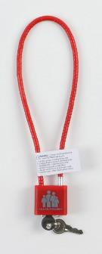

Cable locks
We will make locks available to your clinic
Distribute however makes sense in your clinic workflow (Jesse can help figure this out with you!)
  RECOMMEND storing locks in baskets in exam room as a VISUAL REMINDER!
  Please offer locks to all families- Even families with all firearms locked up or non-owners may want to share locks with others with whom their children spend time (e.g., grandparents)
U.S. Department of Justice. 2015. https://www.safefirearmsstorage.org/safe-storage-options/

Slide 22
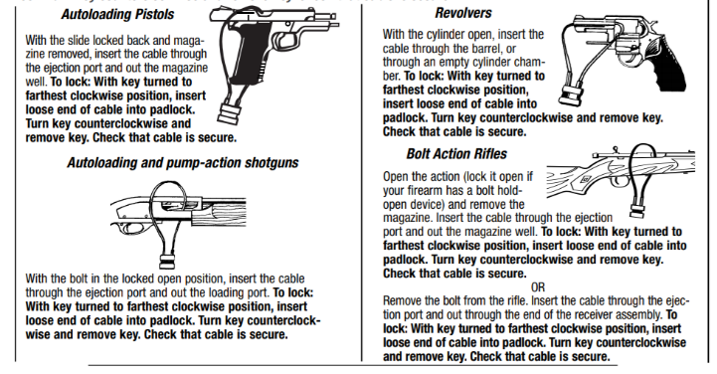
Cable lock installation instructions come with all locks (you don’t need to know how to install)
Notes:
All locks come with instructions for how to use the lock, you don’t need to know how to do this.

Slide 23
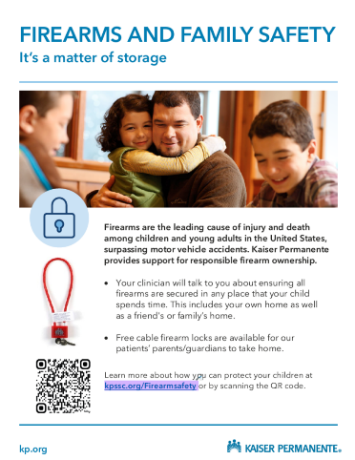
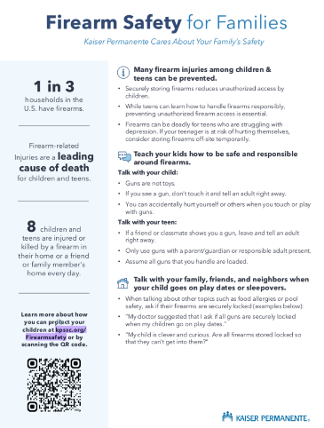
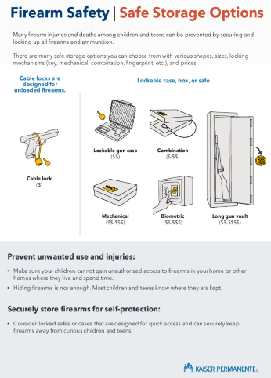
Posters and handouts to support your counseling
Poster
Handout
Notes:
Gun locks are provided, but families may want other options.

Slide 24
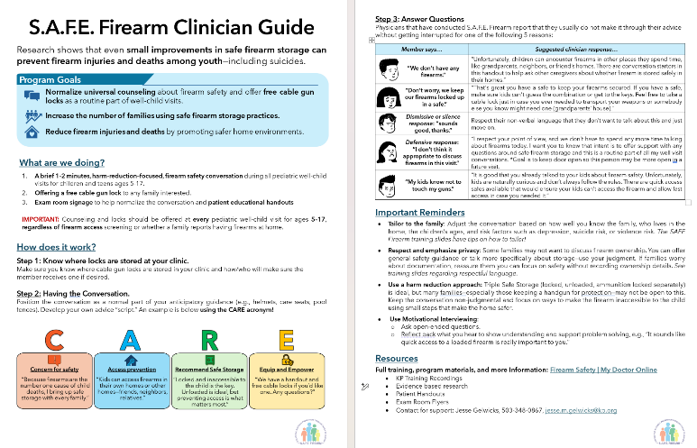
Short clinician guide to reinforce training concepts (2 pages)

Slide 25
Input from clinician Champions
Notes:
Key points: This isn’t that scary, what motivates you to be a champion? Positive experiences with offering locks. Direct them to their champions for the peer support. You already know how to have sensitive conversations, you do this everyday.

Slide 26
Next steps
  Remember C.A.R.E.
  ROLE PLAY with your peers!
  Access the clinician guide
  Know where your locks are stored
  Know who your physician lead is
  Bookmark the S.A.F.E. Firearm Prevention playbook with resources and guidance
  Questions, concerns?
    Call Jesse Gelwicks, 503-348-0867, jesse.m.gelwicks@kp.org
  General launch date is the month of April 2026!

Slide 27
Additional Training Resources from American Academy of Pediatrics
Each video is 2-3 minutes.
Learning to Ask (toddler – school age)
Concerned about personal protection (teens)
Range of solutions (toddler – school age)
Full AAP training available (includes additional scenarios): https://www.aap.org/en/patient-care/gun-safety-and-injury-prevention/safe-storage-of-firearms/

Slide 28
THANK YOU!
We look forward to collaborating on this important work.

Slide 29
SAFE Firearm History
Adapted from the Safety Check Intervention by Shari Barkin
Implemented at all Kaiser Permanente Colorado and Henry Ford Health clinics in 2022 as part of a large implementation study funded by NIH to Rinad Beidas at Northwestern
Pediatric teams continue the program till current day after research funding ended in 2025.
12,000 cable locks were distributed among 40,000 visits over 2 years at KPCO.
Effective implementation strategies found that we will replicate in KPNC
SAFE Firearm significantly improved parent storage behavior
Highly acceptable to patients and clinicians.
Kaiser Permanente’s Community and Social Health is now supporting spread of this effective program across KP regions!
Notes:
Rigorously evaluated:
Implementation strategies including EHR reminder and practice facilitation resulting in a high-impact publication.
Parent storage behavior changes
Fidelity via EHR documentation and parent report
Clinician and patient acceptability

Slide 30
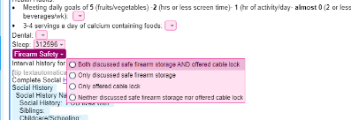
Implementation strategies
Practice facilitation and EHR reminders
n=47,307 well-visits
*Planning EHR reminder for future at KPNC!
Important findings
Physicians need to understand the why and how to initiate the practice (facilitation most helpful here!)
Once physicians start doing it, it’s easy to continue when reinforced by EHR reminders
Prac. Fac. EHR only
Notes:
You will be getting practice facilitation from Jessee Gelwicks.
No EHR reminders for this pilot, planned later when scaled. Posters, handouts, and cable locks will provide visual reminder.

Slide 31
Secure storage behavior change after receiving S.A.F.E. Firearm
Parents who received S.A.F.E. Firearm were significantly more likely to report making firearms more secure following the visit compared to those who didn’t receive the program
Source. Johnson et al., in prep
Notes:
Incidental exposure to S.A.F.E. Firearm (e.g., educational handouts in clinics) could have led some non-recipients to still change behavior

